Slide 1
Maintenance Year 2

Slide 2
Basic marking ,manual & power tools.
Lesson objectives
At the end of the lesson learners should be able :
1. Apply safety rules in the workshop.
2. Name or identify marking and cutting hand tools.
3. To know the uses of making and cutting hand tools.
4. Maintain hand and power tools or machines.
5. To know different types and sizes of sandpapers.
6. To different types of hinges.
7.To know different types of locks.
8. To make a jewelry box.

Slide 3
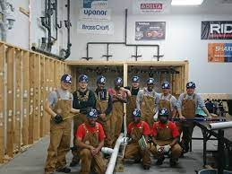
Safety rules in the workshop.
Use protective equipments for eyes, skin and lungs.
Don’t forget to protect your ears.
Watch out for electrical and fire hazards.
Use slip-resistant boots and mats.
Watch out for molds.
Know your chemicals.
Protect against burns.
Be careful where you tea or drink.
Change and seal your clothes after working with sewage.
Wash your hands ……A LOT.
Feedback
Activity: Worksheet 1

Slide 4
Kwa Thema Skills School
Subject : Maintenance Marks :10
Grade : Year 2 Time : 30mins
Date :
Question :1 Safety rules 1. Fill in the following sentences 1.1. Use slip-resistant boots and __________. 1.2. Protect against ________________. 1.3. Know your _______________. 1.4. Be careful where you eat or ______________. 1.5. Watch out for electrical and fire __________. 1.6. Change and seal your clothes after working with ____________. 1.7. Wash your _________ … A LOT. 1.8. Don’t forget to protect your __________. 1.9. Watch out for _____________. 1.10. Use protective equipments for eyes, skin and ____________. (10)

